Slide 1
ROS2 Object Detection and Tracking in field Autonomous Vehicles

Slide 2
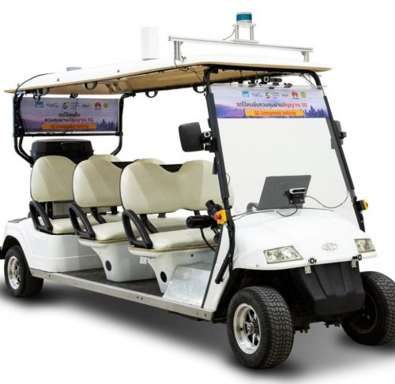
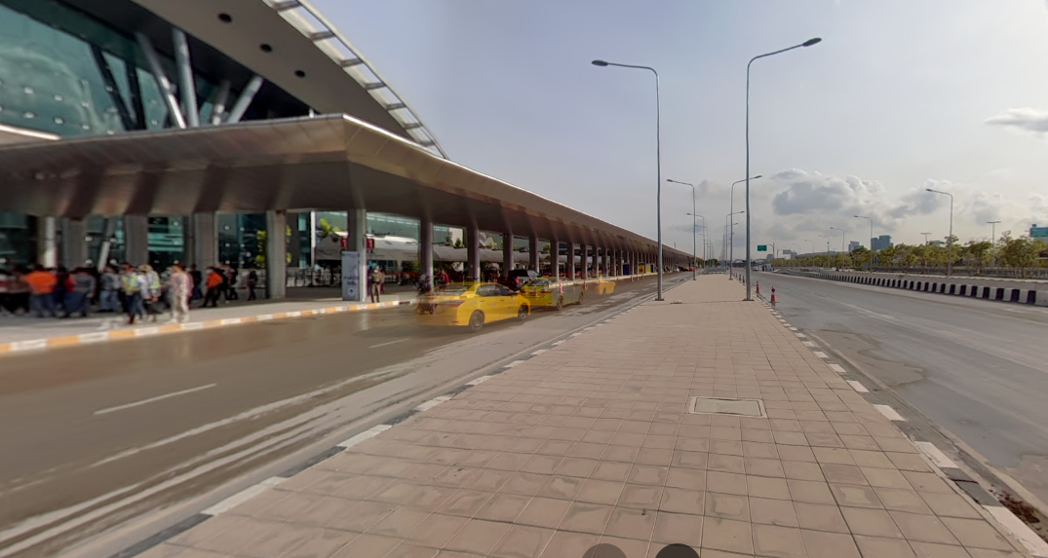
Scope will

Slide 3
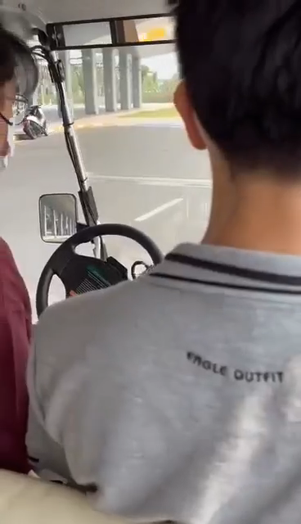
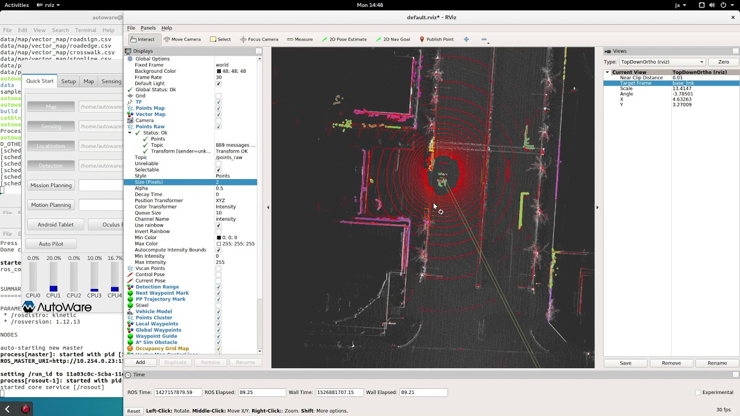
Scope will

Slide 4
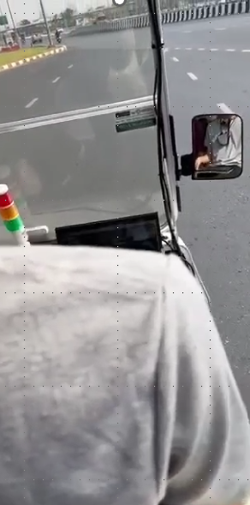
Scope will

Slide 5
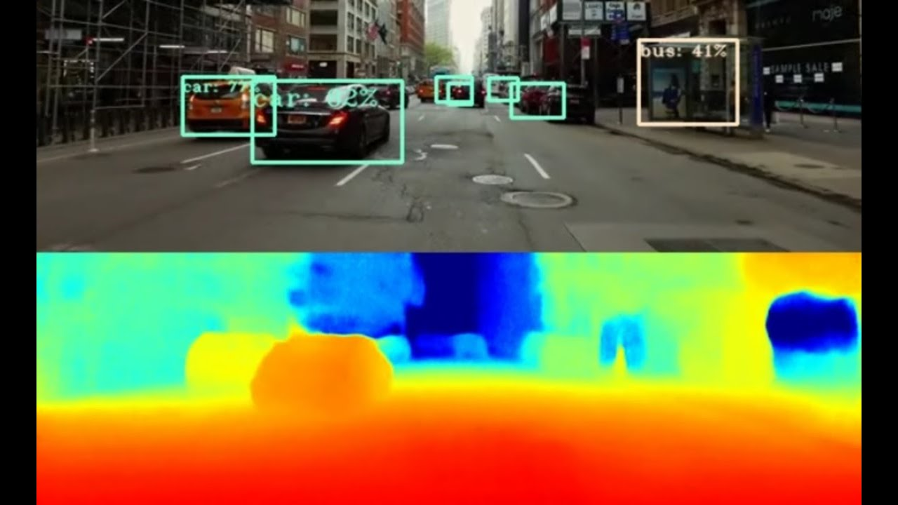
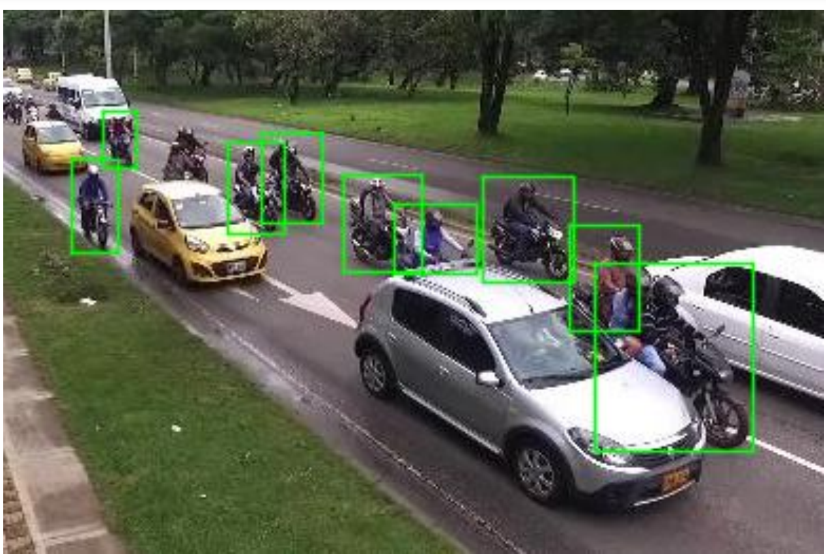
Scope will

Slide 6
Overview
Interface
implement
YOLO
Node detection
Depth camera
Testing
Node estimate pose

Slide 7


Select model
X
faster rcnn

Slide 8
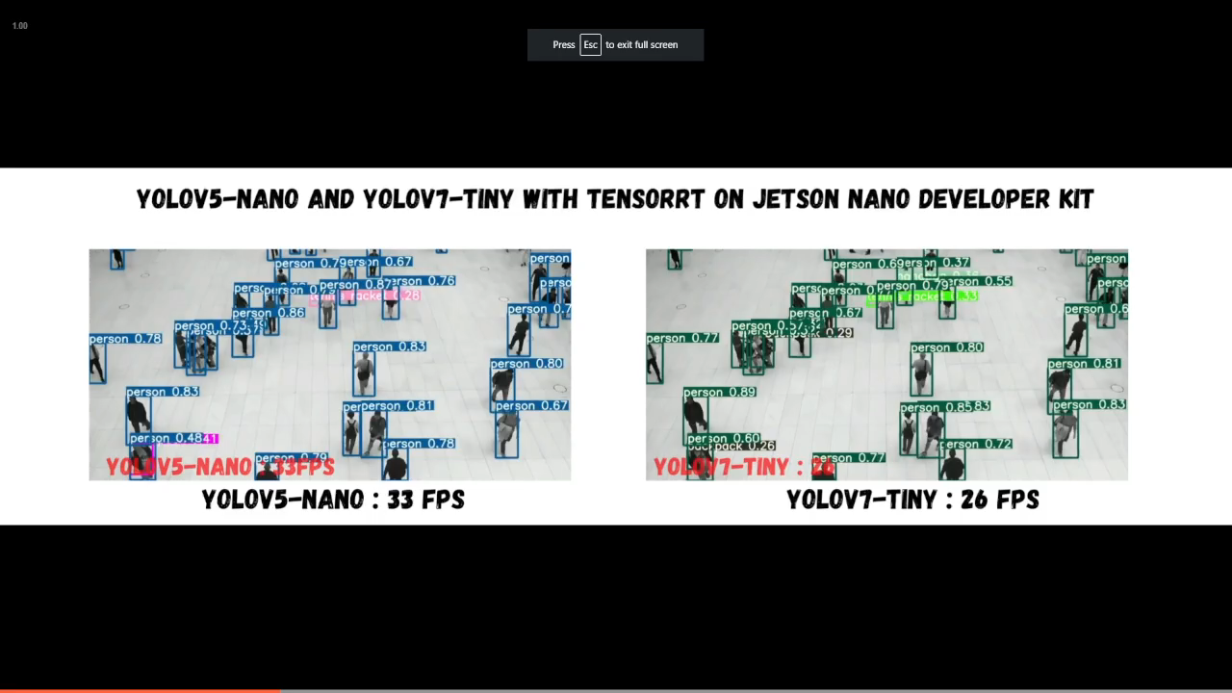
Select model

Slide 9
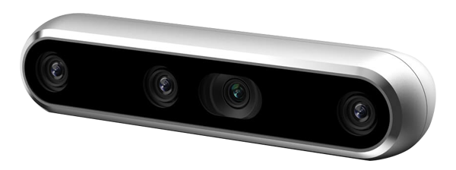
Select camera
Intel realsense Depth camera D455

Slide 10
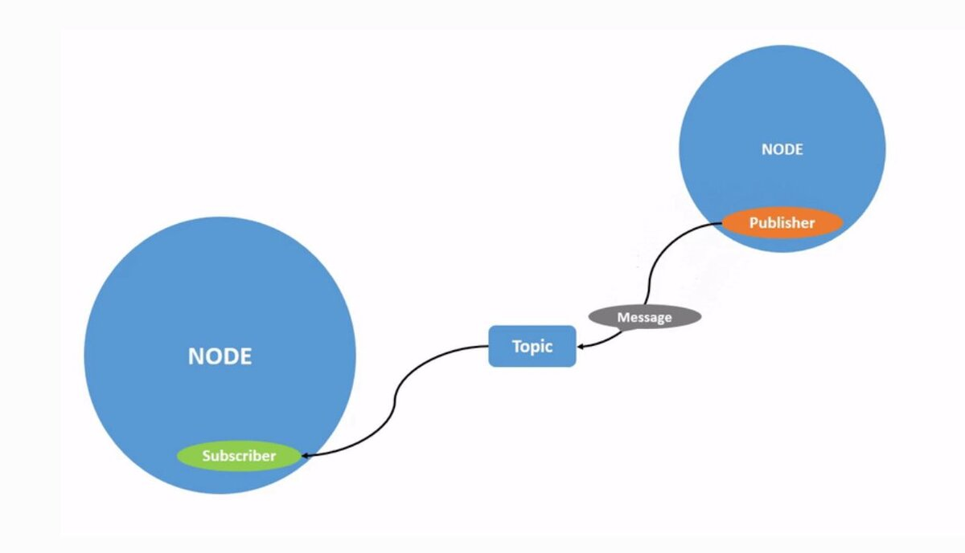

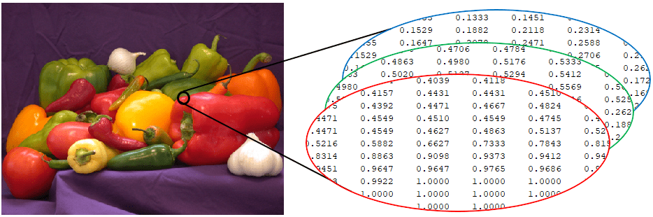
Problem
1280x720

Slide 11
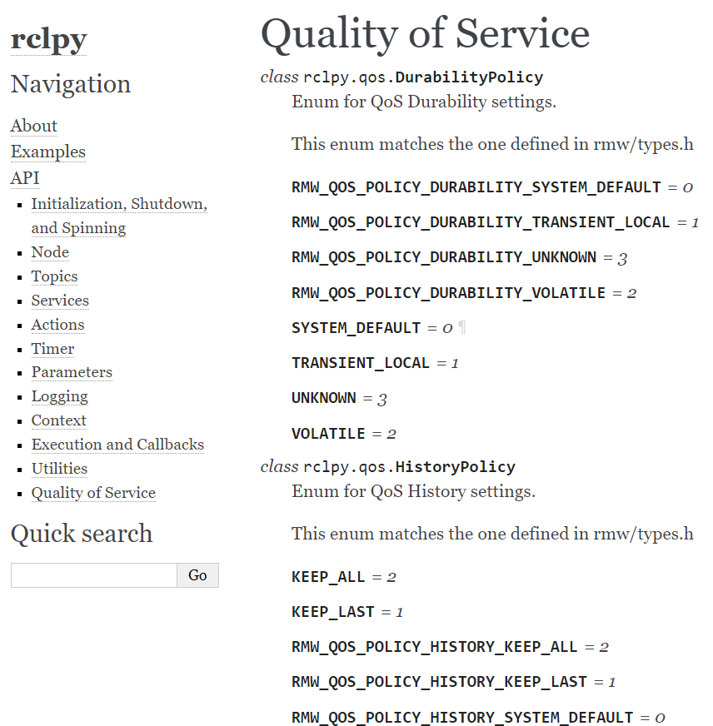
QOS

Slide 12
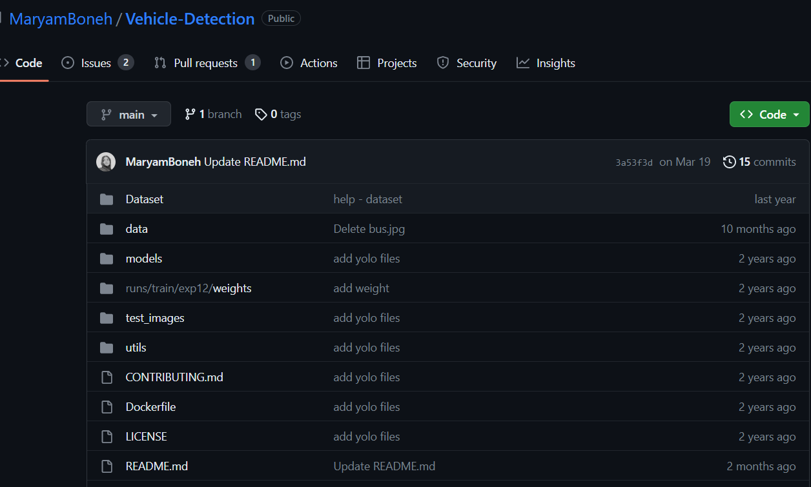
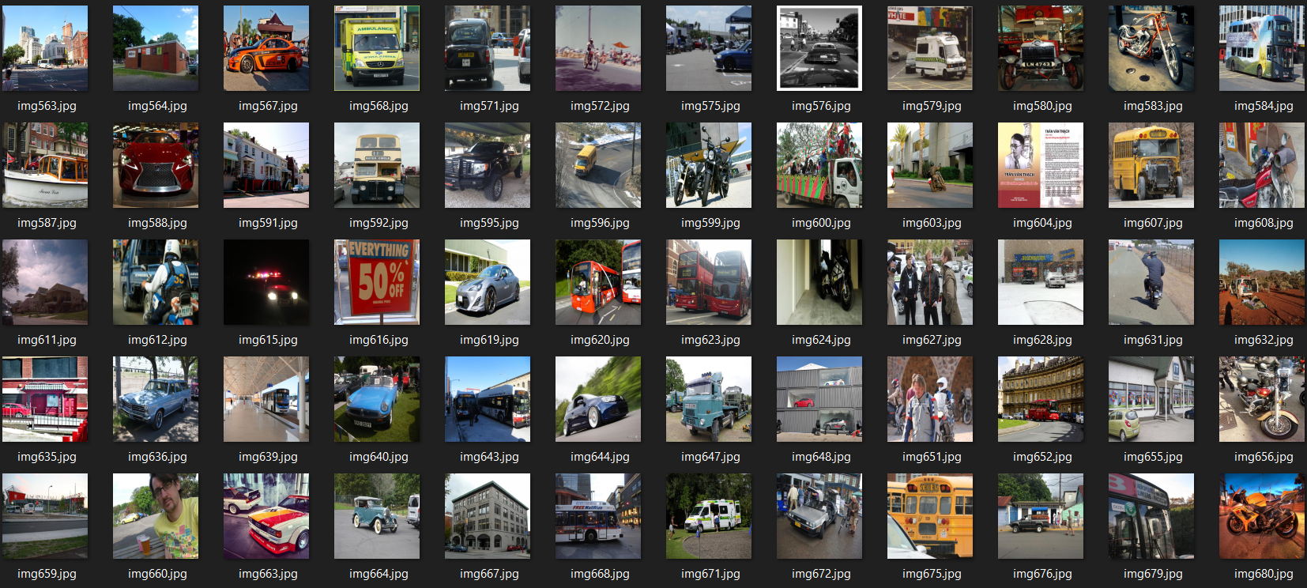
Dataset

Slide 13
Test model
Confidence | Image size | Accuracy | average Runtime/image
0.8 | original size | 0.719457014 | 0.140
0.5 | original size | 0.9095 | 0.140
0.5 | 720x480 | 0.65158371 | 0.041
0.5 | 480x240 | 0.416289593 | 0.035

Slide 14
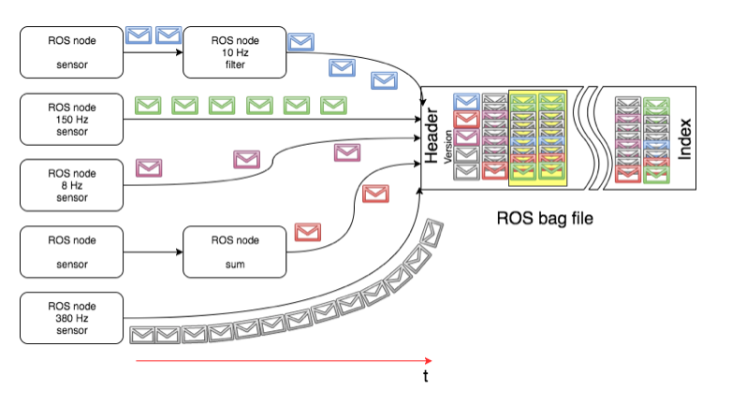
Ros bag

Slide 15
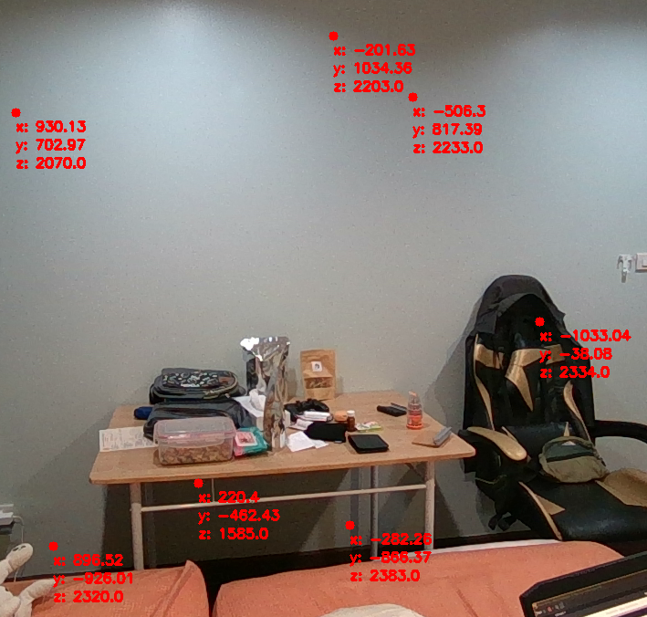
Testing camera
y
y
X
X

Slide 16
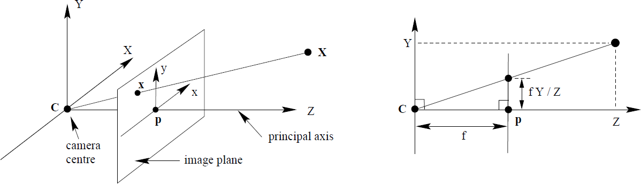
Testing camera

Slide 17
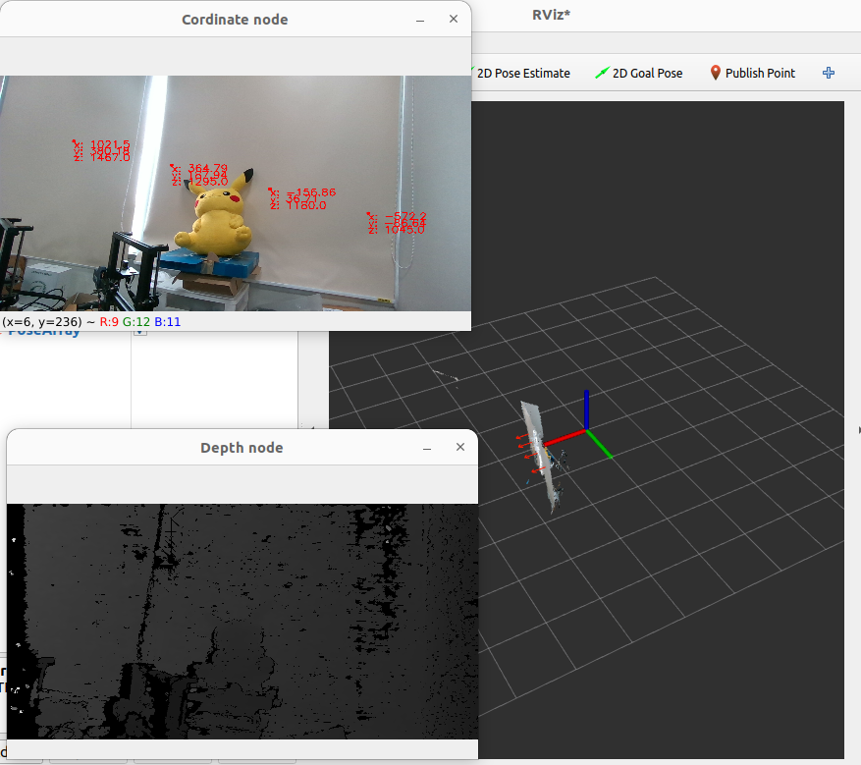
Testing camera

Slide 18
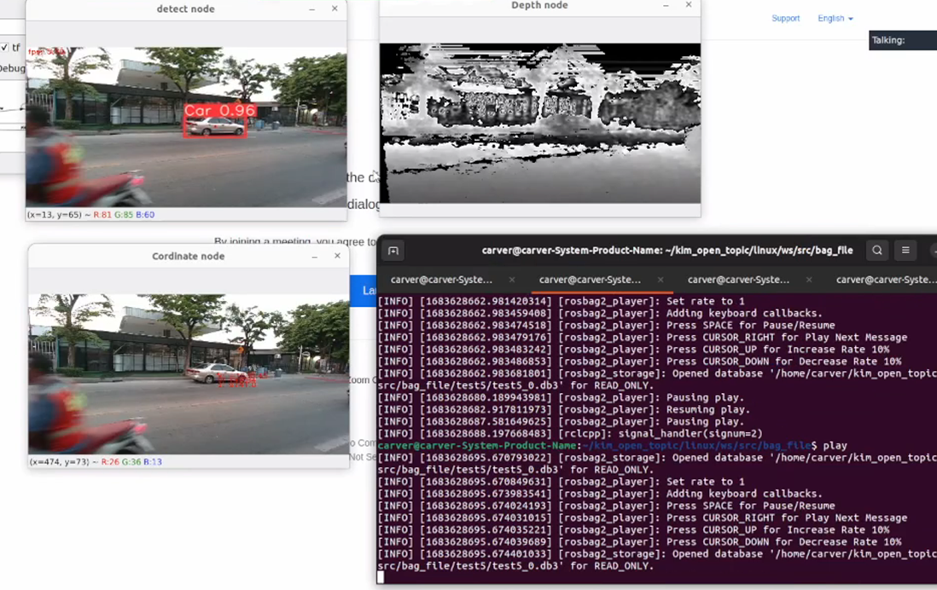
Testing node

Slide 19
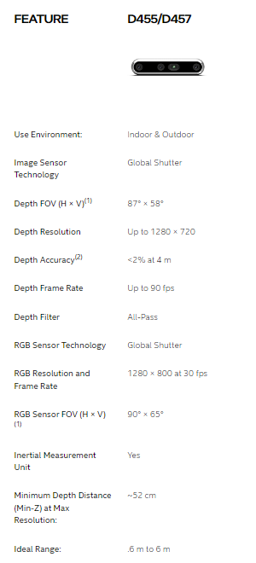
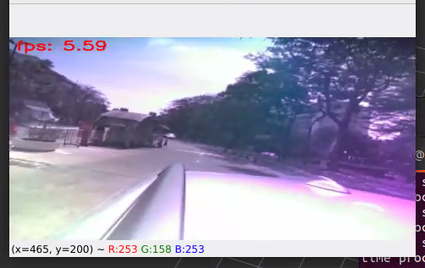
Problem test node
operating temperature 0ºC and 35ºC.

Slide 20
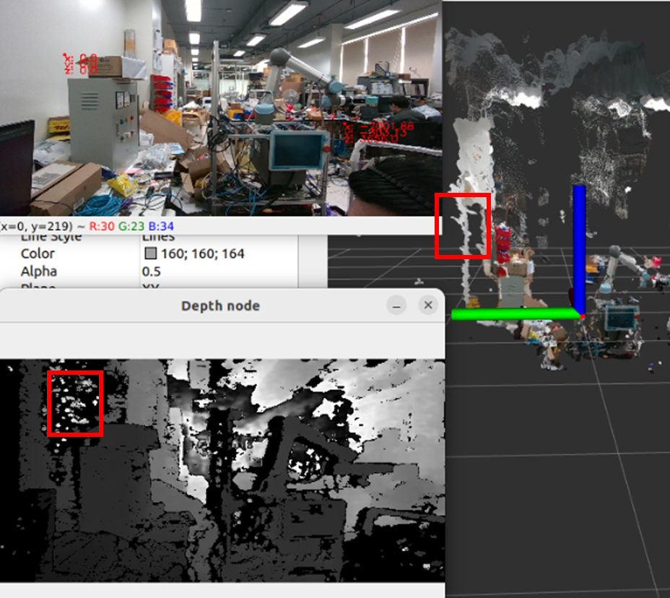
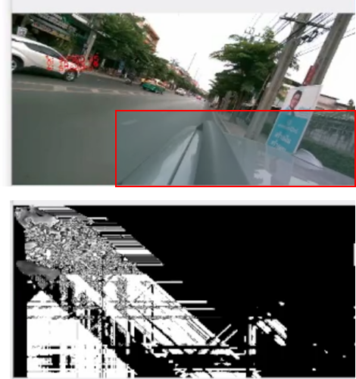
Problem test node

Slide 21
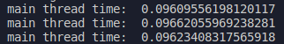
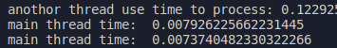
Optimize
Single tread mutithread

Slide 22
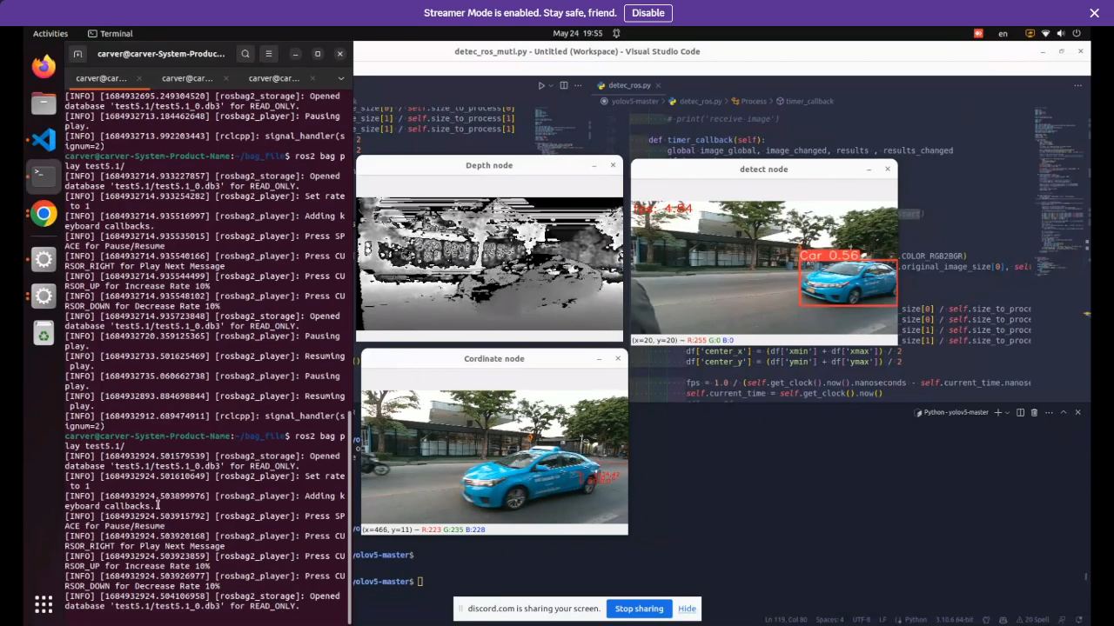
Optimize

Slide 23
Lessons learned
YoloV5
Depth frame
Pinhole camera
Qos
Ros bag
time management
work scurm update

Slide 24
Lessons miss
image recognition
autoware

Slide 25
Thank you

Slide 26
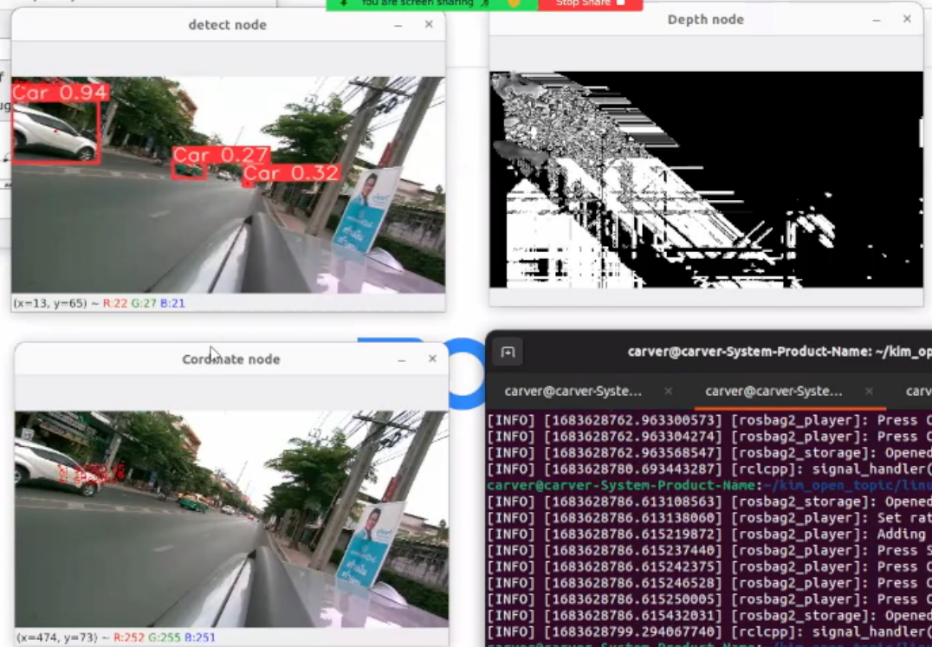
Problem test node

Slide 27
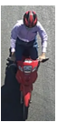
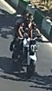
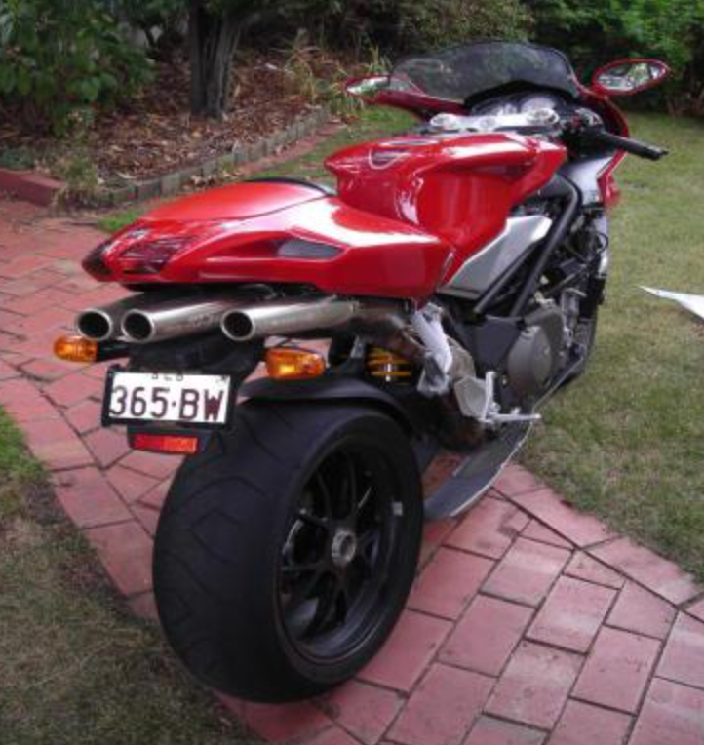
Problem model

Slide 28
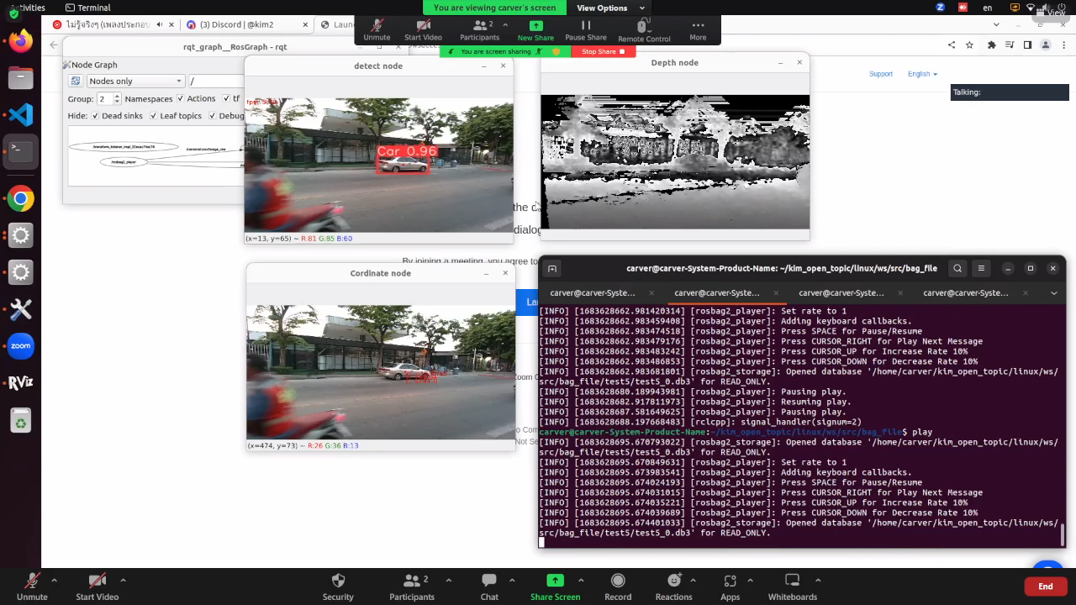
Testing node

Slide 29
Testing node overview

